Slide 1
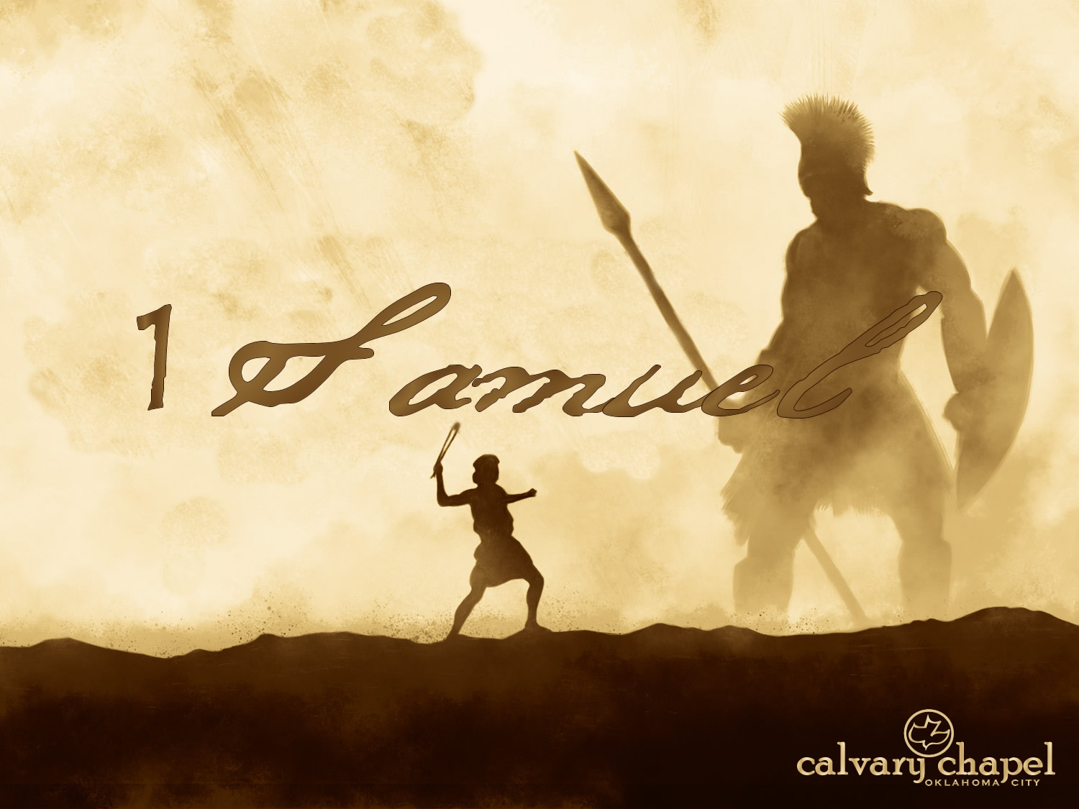

A CD of this message will be available (free of charge) immediately following today's message
This message will be available via podcast later this week at calvaryokc.com
21-22

Slide 2
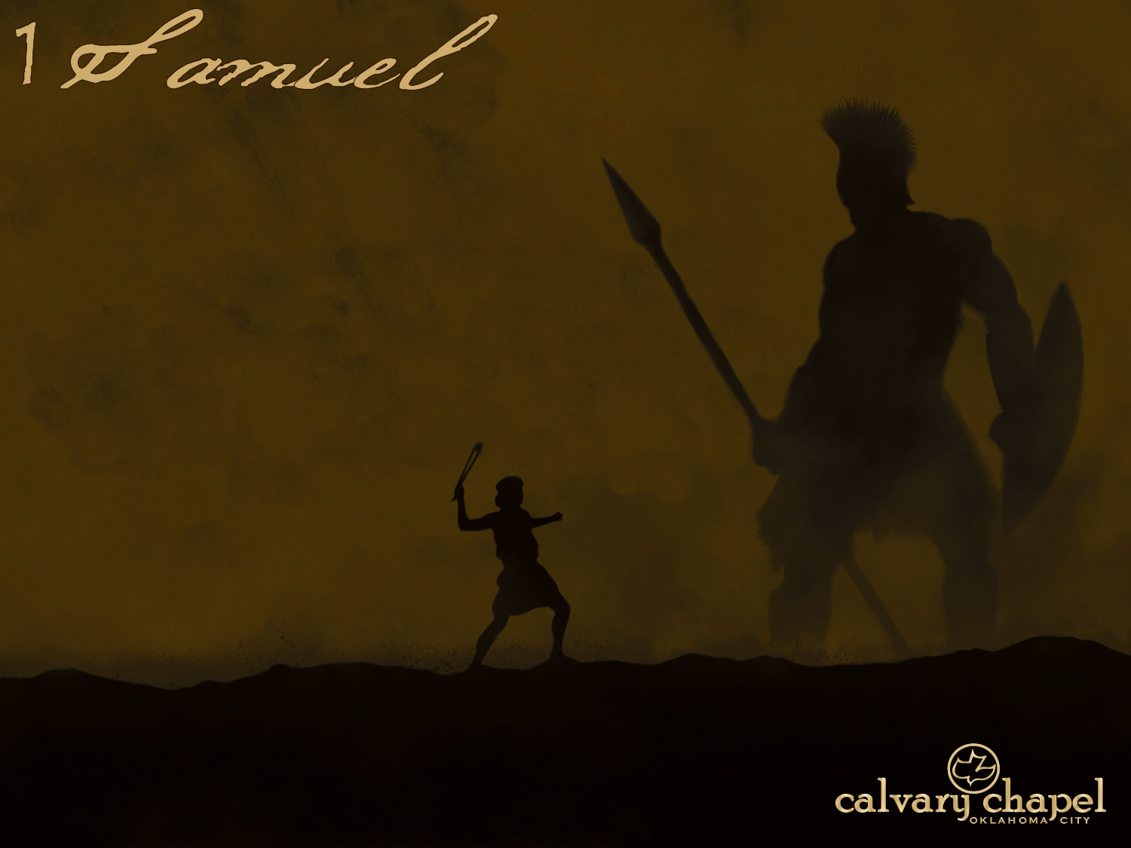
21-22
Tyropoeon Valley
Mt. Scopus (Nob)
Muslim
Qtr.
1 mi.
Christian
Qtr.
Temple
Mount
Kidron Valley
Armenian
Qtr.
City of David
Jebus
Hinnom Valley
Jewish
Qtr.

Slide 3
21-22
Nob ~ high place

Slide 4
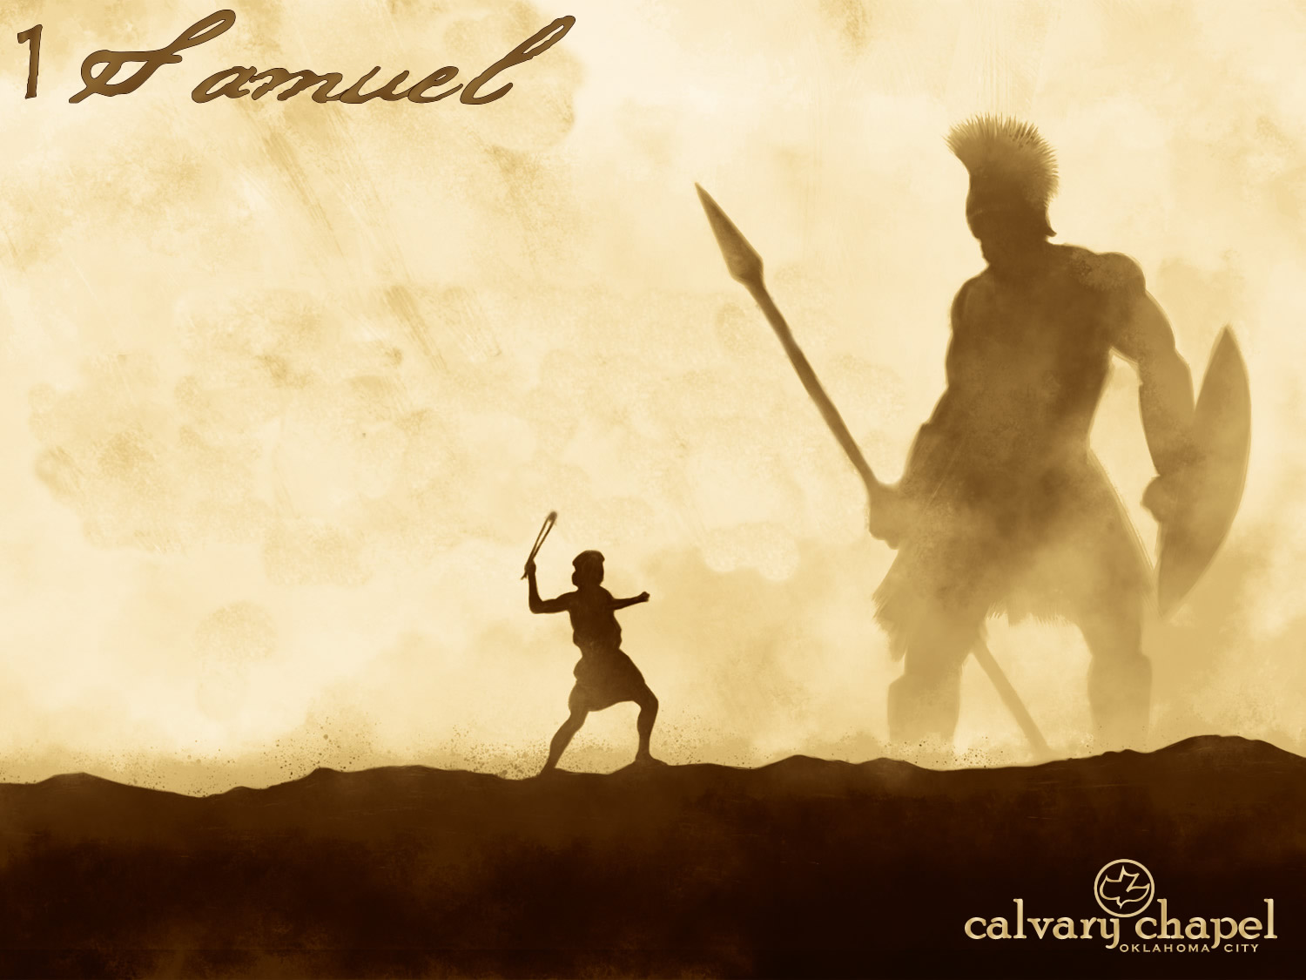
21-22

Slide 5
21-22
2 Cor. 3:6 ~ who also made us sufficient as ministers of the new covenant, not of the letter but of the Spirit; for the letter kills, but the Spirit gives life.
Matt. 12:8 ~ For the Son of Man is Lord even of the Sabbath.

Slide 6
21-22

Slide 7
21-22
Prov. 29:25 ~ The fear of man brings a snare,
But whoever trusts in the Lord shall be safe.
Psalm 34 ~ A Psalm of David when he pretended madness before Abimelech, who drove him away, and he departed.
34:19 ~ Many are the afflictions of the righteous, but the Lord delivers him out of them all.

Slide 8
21-22

Slide 9
21-22
Psalm 57 ~ To the Chief Musician. Set to … A Michtam of David when he fled from Saul into the cave.
Michtam ~ uncertain origin – possibly meaning "worthy of being engraved in gold"
57:1 ~ Be merciful to me, O God, be merciful to me! For my soul trusts in You; And in the shadow of Your wings I will make my refuge, Until these calam-
ities have passed by.

Slide 10
21-22
Psalm 142 ~ A Contemplation (Maschil) of David. A Prayer when he was in the cave.
142: 5 ~ I cried out to You, O Lord: I said, "You are my refuge, My portion in the land of the living."

Slide 11
21-22

Slide 12
21-22
Alan Redpath ~ "Do you see the truth of which this Old Testament story is so graphic a picture? Just as in David’s day, there is a King in exile who is gathering around Him a company of people who are in distress, in debt, and discontented. He is training and preparing them for the day when He shall come to reign."

Slide 13
21-22

Slide 14
21-22
Stronghold ~ metstudah – Masada

Slide 15
21-22

Slide 16
21-22
Sorry ~ NIV, concerned
to have pity

Slide 17
21-22

Slide 18
21-22
Bidding ~ literally, has access to your bodyguard

Slide 19
21-22

Slide 20
21-22
Ps. 52 ~ To the Chief Musician. A Contemplation (Maschil) of David when Doeg the Edomite went and told Saul, and said to him, “David has gone to the house of Ahimelech.”

Slide 21
21-22

